Slide 1
Android TIF Introduction
By Chen Changhong

Slide 2
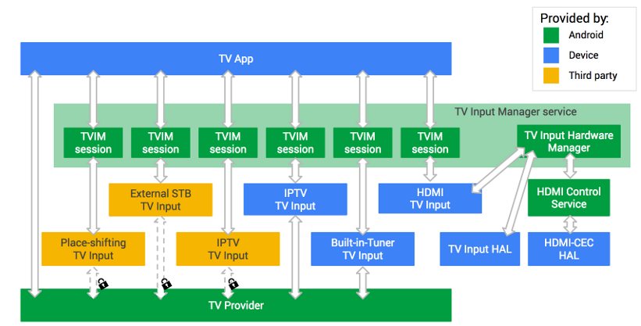
TV Input Framework Architecture
https://source.android.com/devices/tv/

Slide 3
TV App
/packages/apps/TV/src/com/android/tv/TvActivity.java
一个和用户交互的系统应用
Applications talk to the TV input manager to list TV inputs and check their status.
Once an application find the input to use, it uses TvView or TvRecordingClient for further interaction such as watching and recording

Slide 4
TV App
Setup and configuration
Auto-detect TV Inputs
Let TV Inputs initiate channel setup
Control parental settings
Edit channels
Viewing
Access and navigate all TV channels
Access TV program information bar
EPG
Support multiple audio and subtitle tracks

Slide 5
TV Input Manager
/frameworks/base/media/java/android/media/tv/TvInputManager.java
Central system API to the overall TV input framework (TIF) architecture, which arbitrates interaction between applications and the selected TV inputs.
TvInputCallback
Callback used to monitor status of the TV inputs

Slide 6
TvInputManager
监测在系统注册android.media.tv.action.QUERY_CONTENT_RATING_SYSTEMS的类, 将其转换为Input Service
获取TvInputManager
TvInputManager tvInputManager =(TvInputManager) getSystemService(Context.TV_INPUT_SERVICE)
遍历service
List<TvInputInfo> list = tvInputManager.getTvInputList(); for(TvInputInfo info:list) { Log.i(TAG, "id:" + info.getId()); }

Slide 7
TvInputManager
Log
id:com.mediatek.tvinput/.component.ComponentInputService/HW1 id:com.mediatek.tvinput/.dtv.TunerInputService/HW0 id:com.mediatek.tvinput/.composite.CompositeInputService/HW2 id:lenovo.com.ismartvlive/.Ismartvliveservice

Slide 8
TvInputService
/frameworks/base/media/java/android/media/tv/TvInputService.java
实现onCreatSession()方法返回一个TvInputService.Session对象
例子实现
定义/developers/build/prebuilts/androidtv/sample-inputs/app/src/main/AndroidManifest.xml
实现/developers/build/prebuilts/androidtv/sample-inputs/app/src/main/java/com/example/android/sampletvinput/rich/RichTvInputService.java

Slide 9
TvInputService.Session
TvView通过Tune方法来播放指定的节目,
调用Session的onTune(Uri channelUri)方法来播放uri中的节目
onSetSurface()方法来设置播放的surface

Slide 10
TV Input
TV Input
可以看做是一个代表物理或者虚拟的电视接收器或者输入端口的应用。Input在TIF中可以看做是一个输入源
Implement TvInputService
an input source of TV, which can be a pass-through input such as HDMI, or a tuner input which provides broadcast TV programs.
The system binds to the TV input per application’s request. on implementing TV inputs.

Slide 11
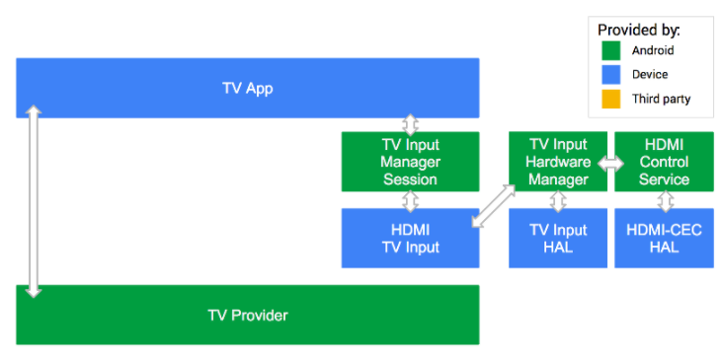
Passthrough input
Some inputs, like the HDMI input or built-in tuner input, can be provided only by the manufacturer as they speak directly with the underlying hardware.
Notes:
To obtain the URI used to reference the passthrough input, use the android.media.tv.TvContract utility method buildChannelUriForPassthroughInput(String inputId). The TV App communicates with the TV Input Manager to reach the HDMI TV Input.

Slide 12
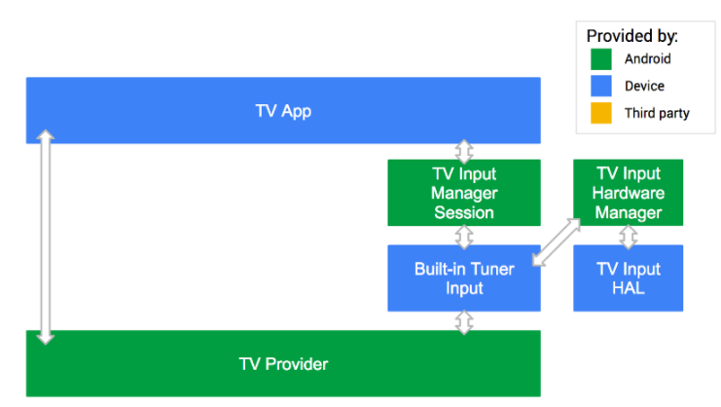
Built-in tuner example
In this example, the Built-in Tuner TV Input provided by the device manufacturer is trusted and has full access to the TV Provider.

Slide 13
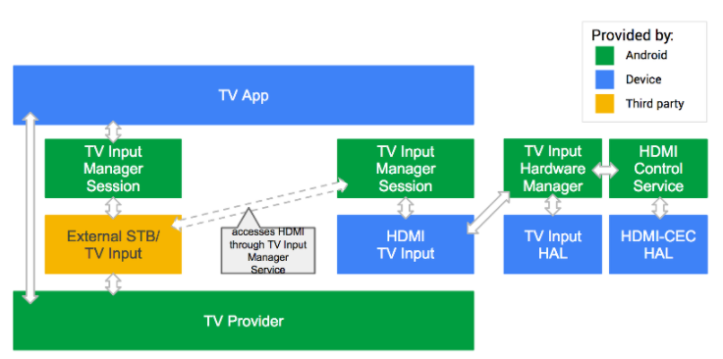
Third-party input example
the external STB TV Input is provided by a third party. Since that TV Input can’t directly access the HDMI video feed coming in, it must go through the TV Input Manager and use the HDMI TV Input provided by the device manufacture.
Notes:
Through the TV Input Manager, the external STB TV Input can speak with the HDMI TV Input and ask it to show the video on HDMI1. So the STB TV Input can control the TV while the manufacturer-provided HDMI TV Input renders the video.

Slide 14
TV Input HAL
TV Input HAL
tv_input module
TV Input的硬件抽象层，可以让系统的TV inputs访问TV特有硬件

Slide 15
Others
Parental Control
儿童锁，一种可以锁住某些频道和节目的技术
HDMI-CEC
通过HDMI在多种设备上进行远程控制

Slide 16
TvView
/frameworks/base/media/java/android/media/tv/TvView.java
负责显示播放的内容
切台的入口，内置surface用于显示视频播放的内容和通过控制session可以控制音量的大小等

Slide 17
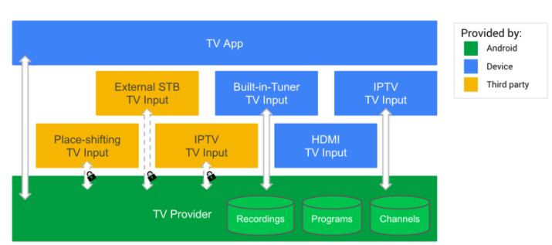
TV Provider
/packages/providers/TvProvider/src/com/android/providers/tv/TvProvider.java
The TV Provider database stores the channels and programs from TV Inputs
Passthrough TV inputs do not store channels and programs.

Slide 18
TvContract
/frameworks/base/media/java/android/media/tv/TvContract.java
The contract between the TV provider and applications. Contains definitions for the supported URIs and columns
TvContract.Channels 频道列表
TvContract.Programs 频道里面的节目单

Slide 19
TvInputInfo
/frameworks/base/media/java/android/media/tv/TvInputInfo.java
specify meta information of a TV input
Type(Tuner/Composite/Svideo/HDMI/….)
Label
Icon

Slide 20
TvInputCallback
/frameworks/base/media/java/android/media/tv/TvInputManager.java
Callback used to monitor status of the TV inputs
onInputStateChanged()
onInputAdded()
onInputRemoved()
onInputUpdated()
onTvInputInfoUpdated()
Usage
/packages/apps/TV/src/com/android/tv/MainActivity.java
mTvInputManagerHelper.addCallback(mTvInputCallback);

Slide 21
TvInputHal(Java)
/frameworks/base/services/core/java/com/android/server/tv/TvInputHal.java
Provides access to the low-level TV input hardware abstraction layer
Call Native Function
nativeOpen
nativeAddOrpdateStream
nativeRemoveStream
nativeGetStreamConfigs
nativeClose
Called by Native function
onDeviceAvailabledeviceAvailableFromNative()
onDeviceUnavailable
onStreamConfigurationChanged
onFirstFrameCaptured

Slide 22
TvInputHal(Native)
/frameworks/base/services/core/jni/com_android_server_tv_TvInputHal.cpp
register_android_server_tv_TvInputHal()
Class JTvInputHal
nativeOpen
JTvInputHal::createInstance()
sp<ITvInput> tvInput = ITvInput::getService()
return new JTvInputHal(env, thiz, tvInput, looper))
nativeAddOrUpdateStream
tvInputHanl->addOrUpdteStream(deviceId, streamId, surface)
mTvInput->getStreamConfigurations()
mTvInput->openStream(deviceId, streamId)

Slide 23
TV Input Skeleton
/hardware/interfaces/tv/input/1.0/default/TvInput.cpp
/hardware/interfaces/tv/input/1.0/default/TvInput.h
struct TvInput : public ITvInput
{
}

Slide 24
TV HAL module skeleton
/hardware/libhardware/modules/tv_input/tv_input.cpp
/hardware/libhardware/include/hardware/tv_input.h
tv_input_module_t
.methods = &tv_input_module_methods
tv_input_module_methods =
// return hw_device_t of tv_input_private_t
.open = tv_input_device_open
tv_input_private_t
tv_input_device_t device
struct hw_device_t common
int (*initialize)(..)
int (*get_stream_configurations)(…)
int (*open_stream)(…)
const tv_input_callback_ops_t* callback

Slide 25
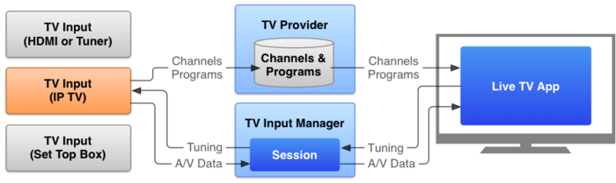
Flow

Slide 26
Example
https://github.com/songwenju/TIFSample

